Slide 1
Tower of Eisenhower
By John-Martin Devera

Slide 2
Problem: Procrastination
Research psychologist definition: “The voluntary delay of an intended action despite knowing that one will probably be worse off for the delay”¹
Affects approximately 30% to 60% of undergraduates regularly postpone academic work²
Consequences include: Increased health risks, compromised performance and progress, decreased learning, lost opportunities, and strained relationships. ²
May manifest anxiety, irritation, regret , despair, and/or self blame²
1. Steel, P. (2007). The nature of procrastination: A meta-analytic and theoretical review of quintessential self-regula-
tory failure. Psychological Bulletin, 133 , 65–94.
2. Rabin, L. A., Fogel, J., & Nutter-Upham, K. E. (2011). Academic procrastination in college students: The role of self-reported executive function. Journal of Clinical and Experimental Neuropsychology, 33, 344–357

Slide 3
Related Work: Studies
Sirois and Pychyll: “Current research indicates that increases or decreases in different mood states may prevent or promote future procrastination.”³
Neuropsychologists Rabin, Fogel, and Nutter-Upham: Found a significant correlative between executive functioning (on 9 subscales) and procrastination. ¹
1. Steel, P. (2007). The nature of procrastination: A meta-analytic and theoretical review of quintessential self-regula-
tory failure. Psychological Bulletin, 133 , 65–94.
3. Sirois, F. M. & Pychyl, T. A. (2013). Procrastination and the Priority of Short-Term Mood Regulation: Consequences for Future Self. Social and Personality Psychology Compass, 7, 115–127.

Slide 4
Related Work: Current Applications
Procraster: Leverages short term rewards; 25 min work, then reward
(10 + 2)x5 : Based on Merlin Mann’s technique of 10 min of work, 2 min of break, repeated 5 times over an hour.
EISENHOWER: Strict adherence to Eisenhower model.
Benefits: simple, multilingual, supports calendar and email for iPhone.
Limitations: No support for repeated tasks, max 8 per quadrant, items have to be manually sorted, no sub-tasks

Slide 5
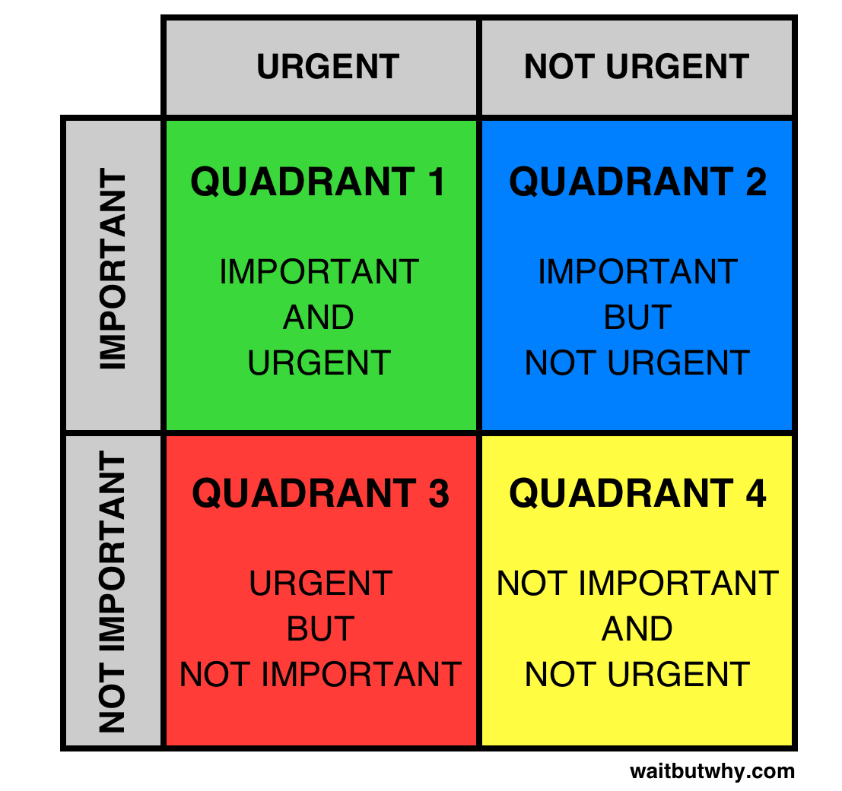
My Solution
The Eisenhower Tower: A gamified prioritized task list supported by visualization.
Uses a modified version of the Eisenhower Matrix[3x3xContiuous]
Added pleasure dimension (high, neutral, low)
Urgency determined by time left and time required to complete
Importance has additional medium importance, and is slightly weighted by sub-tasks.
3 Views
Task View
Game View
Data View
2. Sirois, F. M. & Pychyl, T. A. (2013). Procrastination and the Priority of Short-Term Mood Regulation: Consequences for Future Self. Social and Personality Psychology Compass, 7, 115–127.

Slide 6
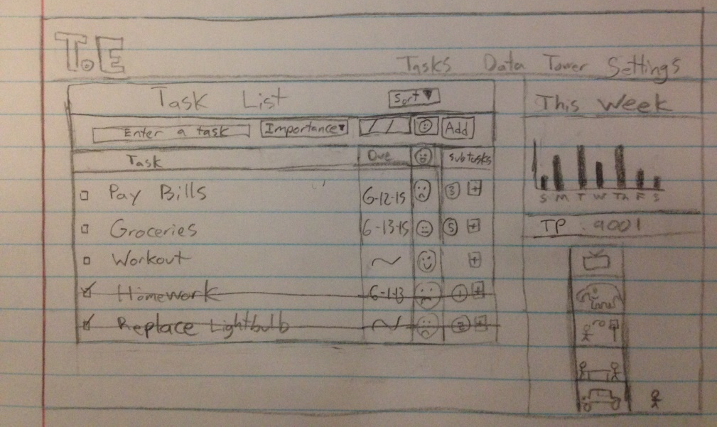
Solution: Task View

Slide 7
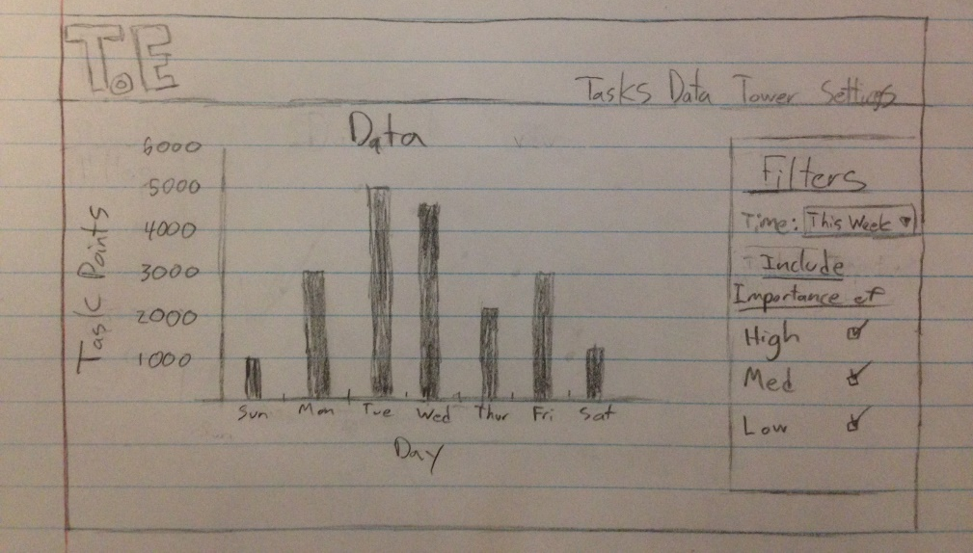
Data View

Slide 8
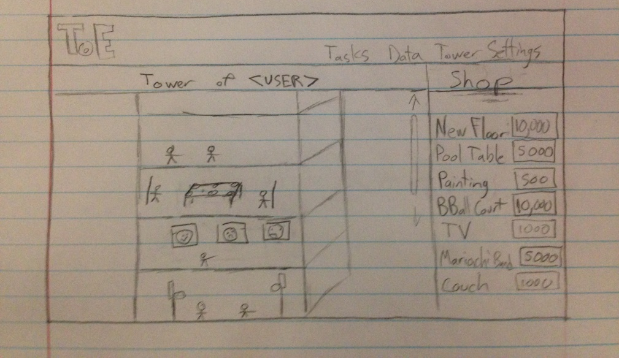
Game View

Slide 9
Main Tasks
Research and understand the problem
Research Papers & Journals
Similar Applications
Brainstorm solutions
Created own algorithm to account for pleasure factor
Decided on Web Application
Design pages
Code Everything
Perform Survey, analysis, and evaluation

Slide 10
Evaluation
Survey
Minimum 10 Volunteers
Pre-survey to identify behaviors and procrastination tendencies
Post-survey to identify effectiveness of app
Short term: 3 days insight for short term

Slide 11
Demo!
http://students.washington.edu/jmdevera/info498a/FinalProject/todolist.php

Slide 12
Souces
Rabin, L. A., Fogel, J., & Nutter-Upham, K. E. (2011). Academic procrastination in college students: The role of self-reported executive function. Journal of Clinical and Experimental Neuropsychology, 33, 344–357
Steel, P. (2007). The nature of procrastination: A meta-analytic and theoretical review of quintessential self-regulatory failure. Psychological Bulletin, 133 , 65–94.
Sirois, F. M. & Pychyl, T. A. (2013). Procrastination and the Priority of Short-Term Mood Regulation: Consequences for Future Self. Social and Personality Psychology Compass, 7, 115–127.
http://www.pcworld.com/article/2094846/read-this-now-7-clever-mobile-apps-to-conquer-procrastination.html

